Slide 1
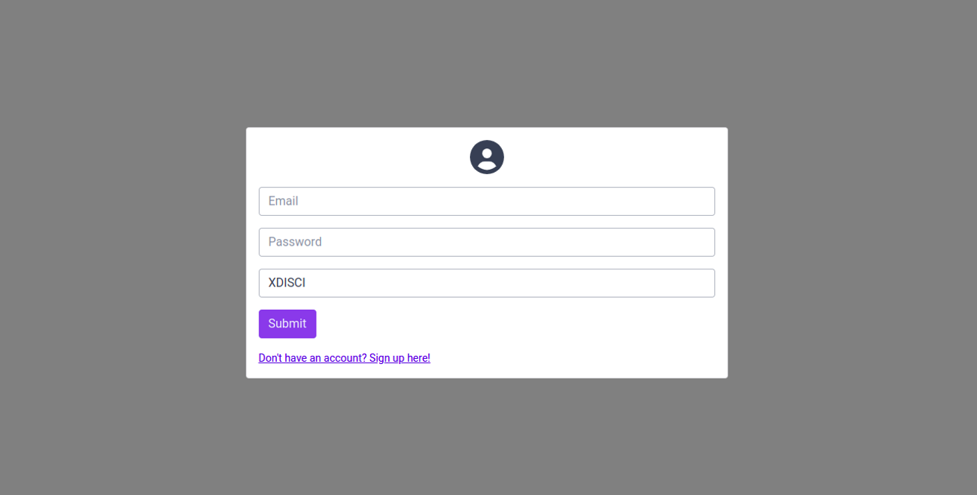
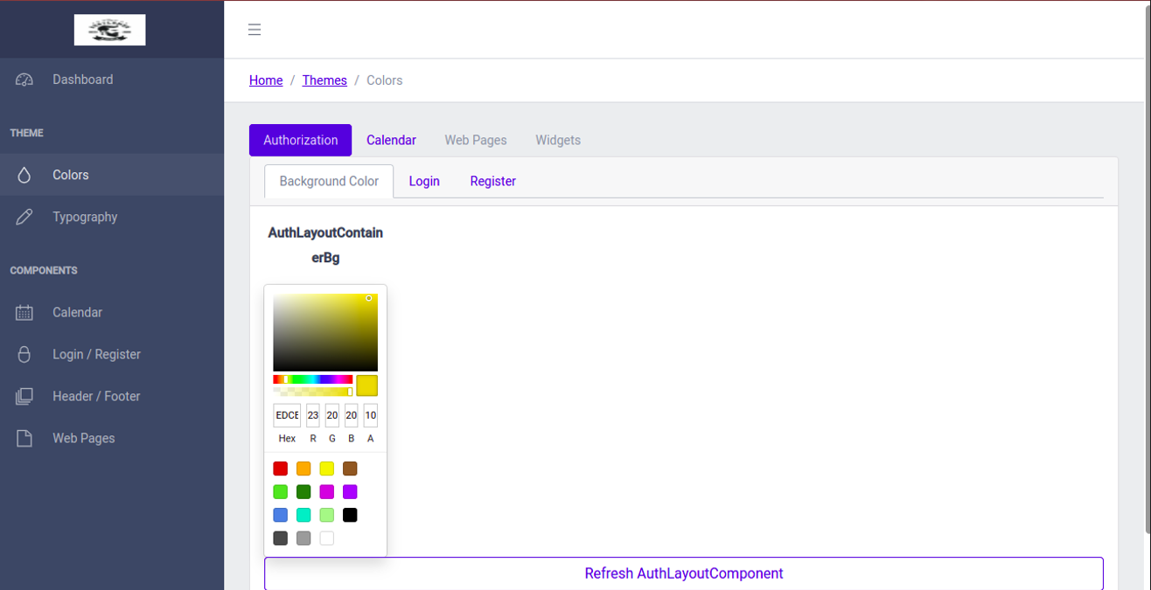
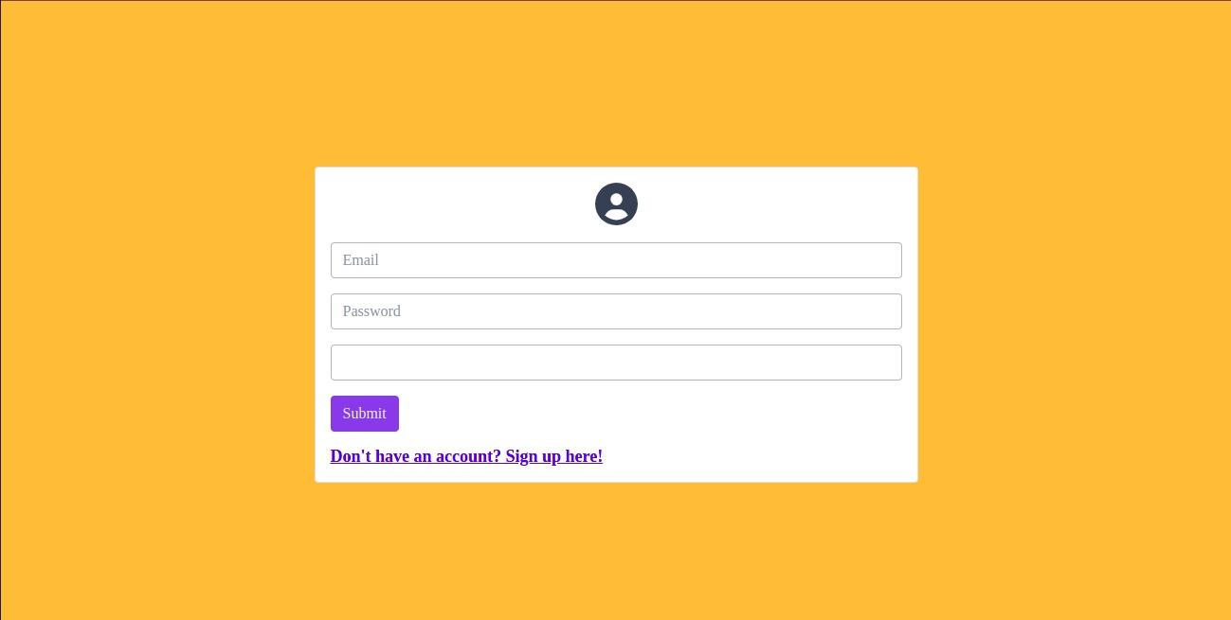
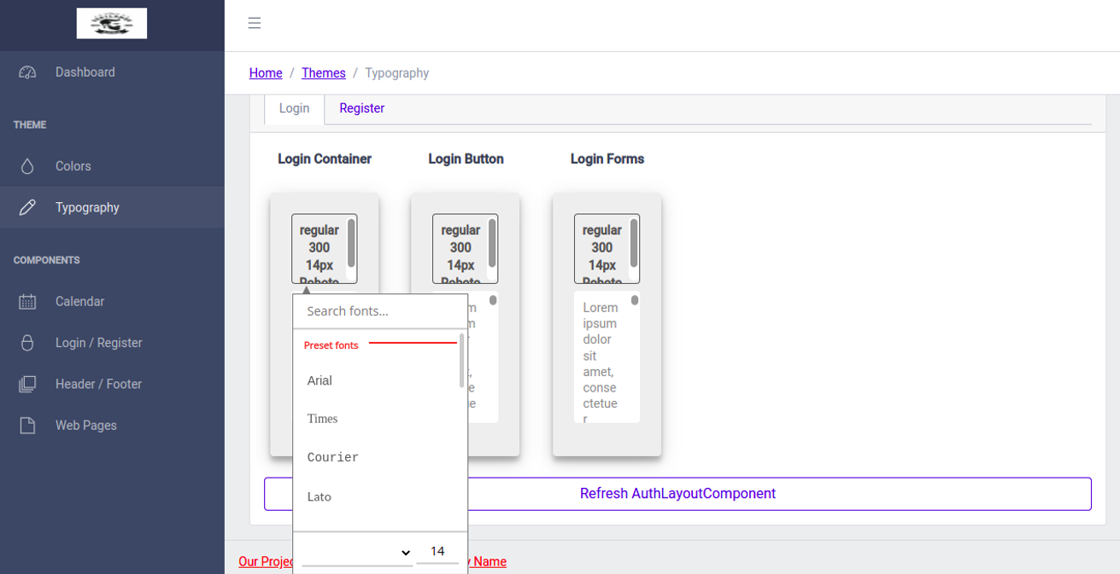
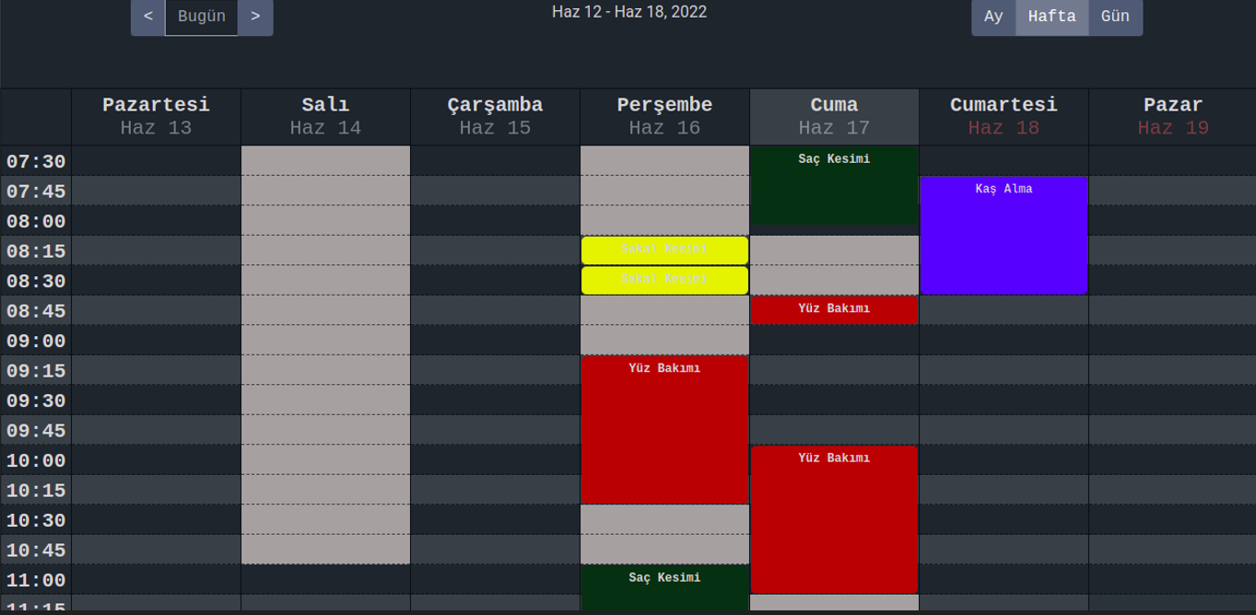
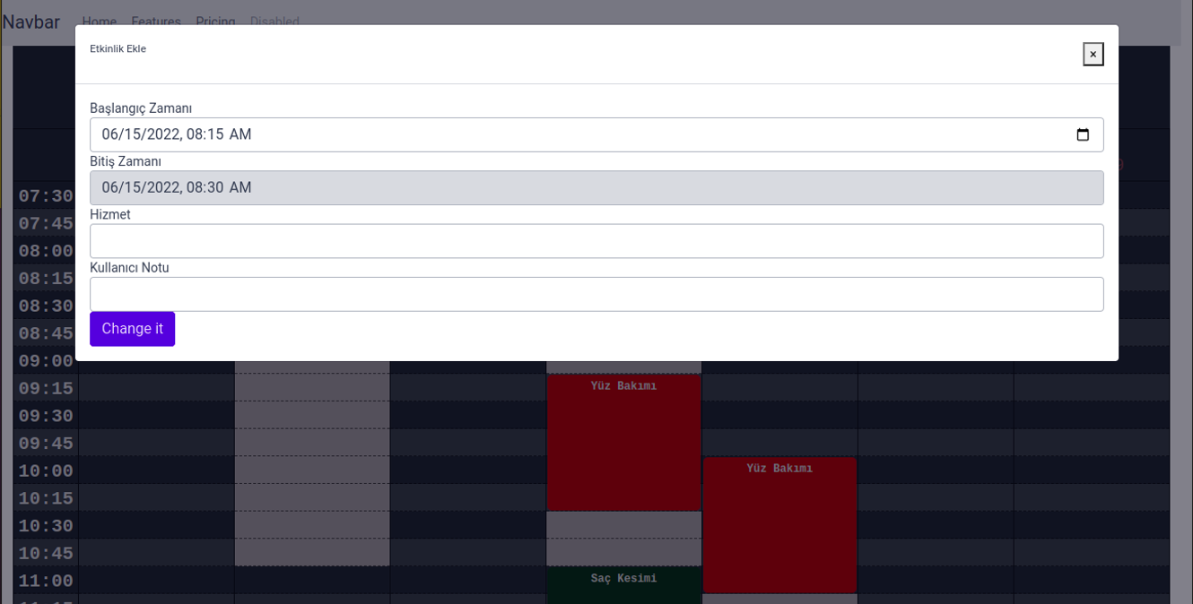
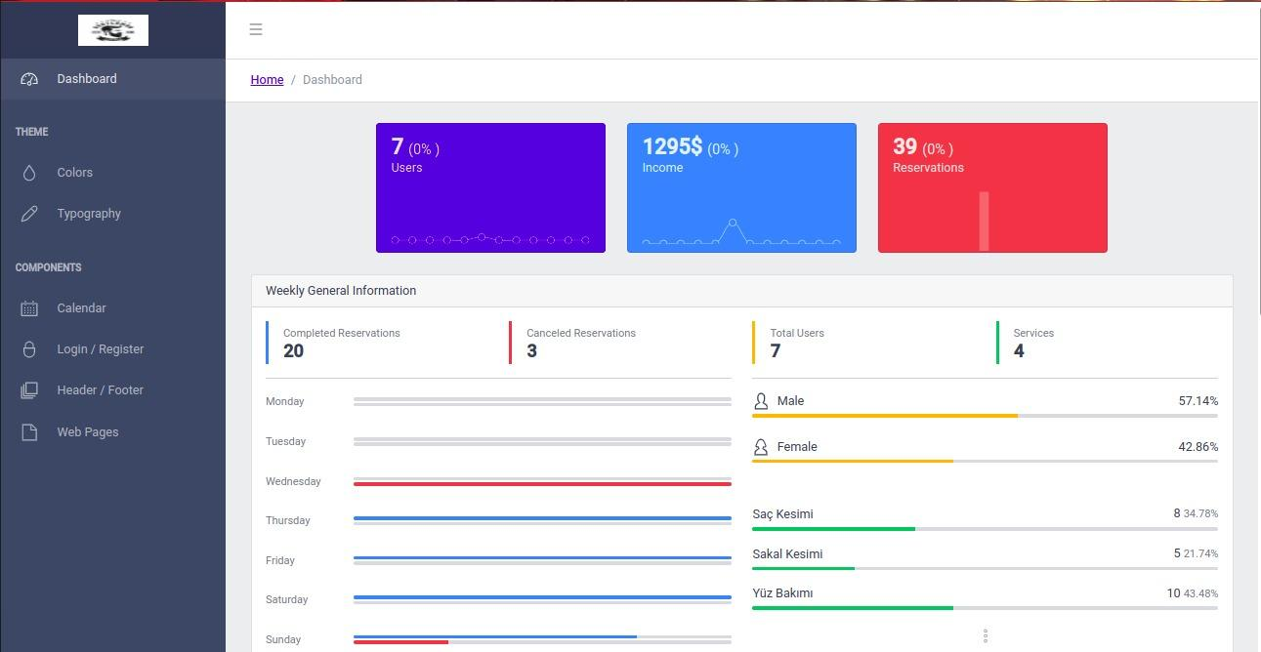
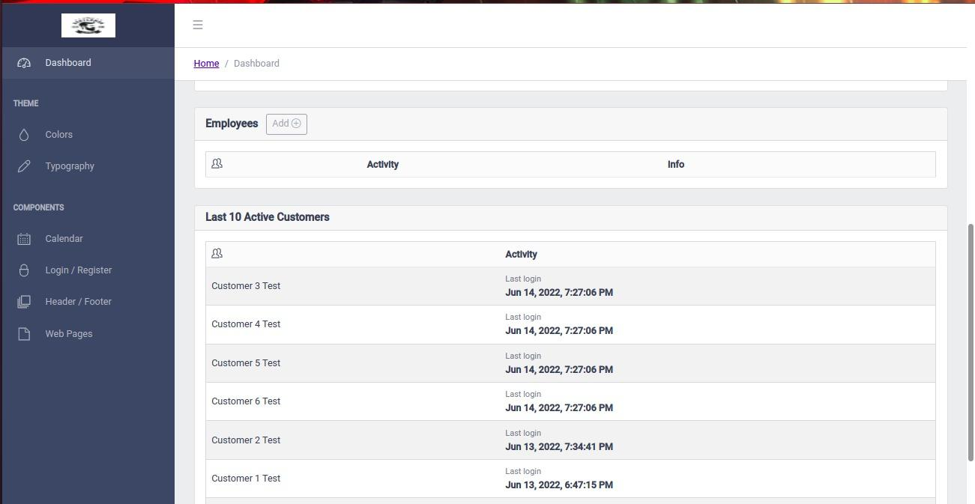
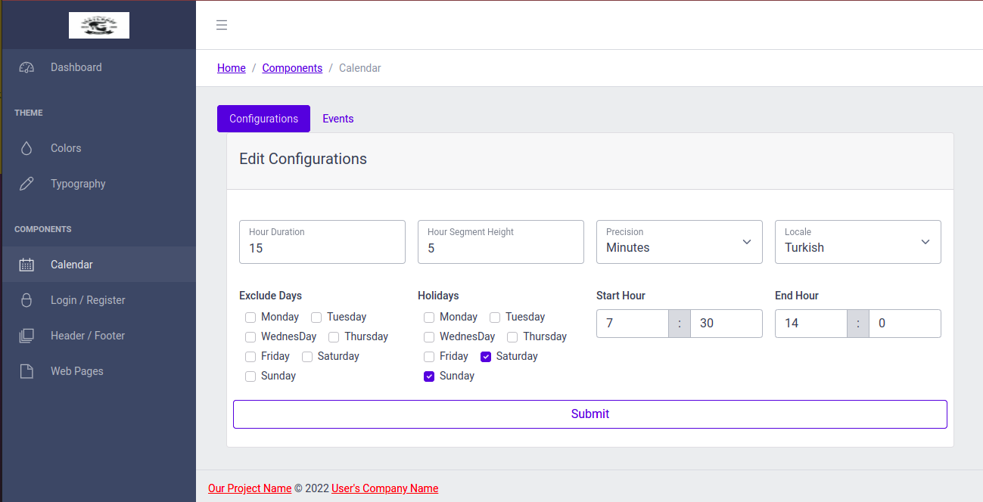
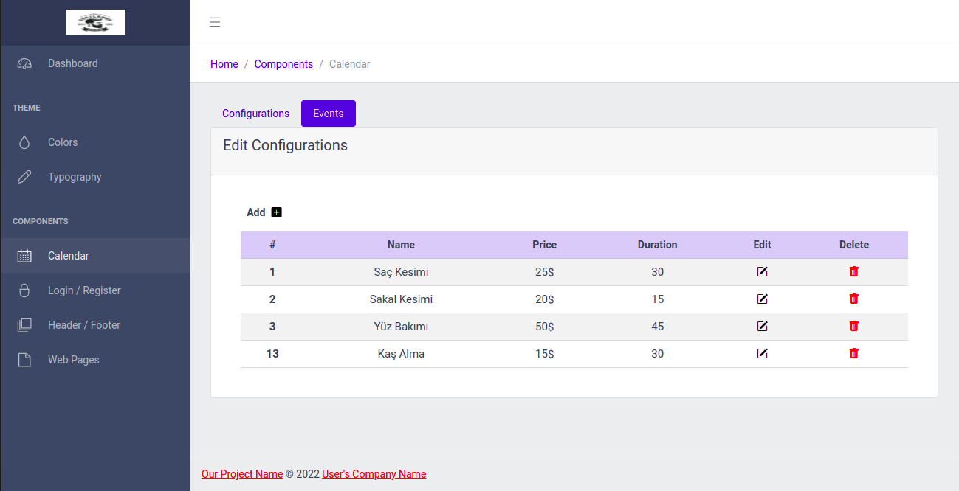
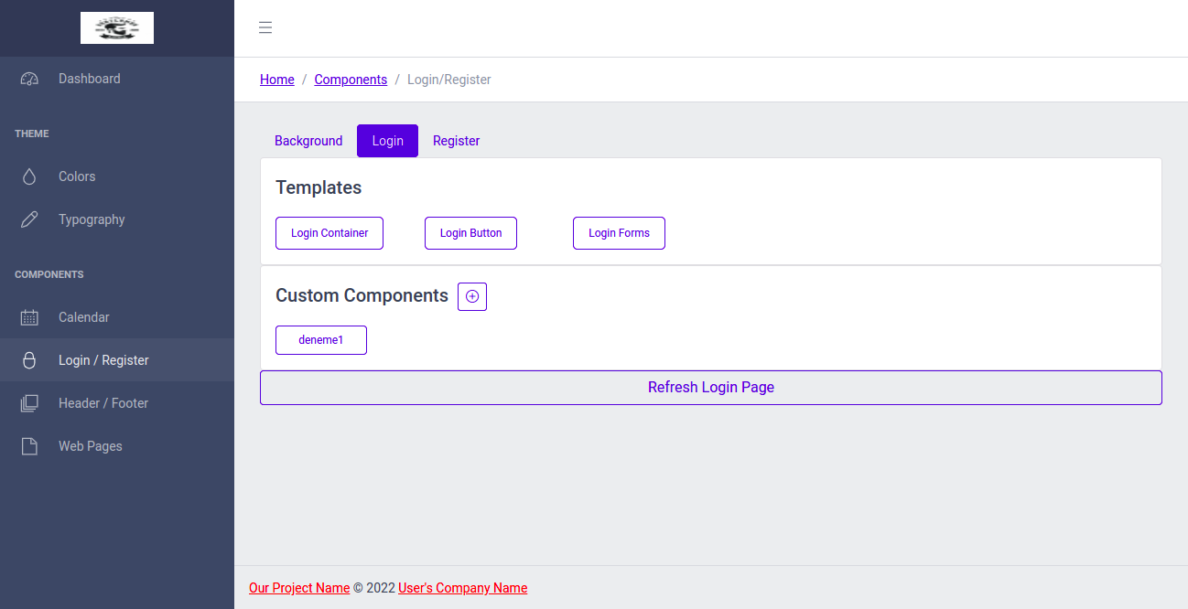
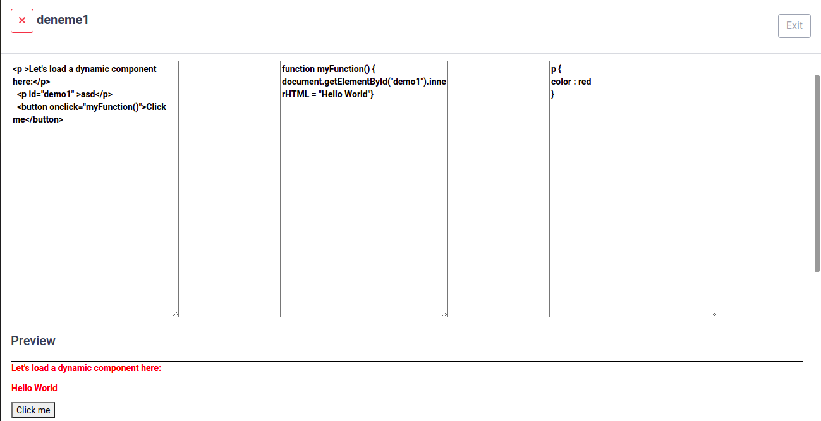
SUMMARY
DYNAMIC AND CUSTOMIZABLE ONLINE RESERVATION PROGRAM
Software Engineering
2021-2022 Capstone Project
Ahmet Arif Özçelik & Onur Akalın
Nowadays, business owners or companies must use a reservation system to keep track of their reservations and should inform the customers about reserved times. Many large companies often work with a secretary to provide this reservation tracking. However, in small-budget businesses, either the owner or an employee does this manually. Requirements and needs vary from job to job. Applications that meet these requirements and needs are usually developed and priced specifically for a company or business. Due to these customizations, multiple projects emerge, and since they are all designed from scratch, the cost is high. Our project focuses on solving this problem.
After Development
Our project has been completed as stated in the introduction section of this report. There was some deviation in the database design part, but this did not have any effect on the flow of the project. We had to use different operating systems and tools during the development process. We used Docker to avoid compatibility and stabilization issues that this could cause.
Our project, where business owners can set their own rules and customize it as they wish, has been completed. We added a detailed dashboard module to our project in addition to the ones mentioned in the introduction part of this report. Thanks to this module, business owners will not only be able to track their reservations, but also instantly monitor weekly and monthly status reports. These status reports provide detailed information such as the total number of weekly and monthly reservations, the last active users who have logged into the application, the services booked, the total number of reservations for which service, and the monthly average income calculation depending on the fees of the services.
The Innovation (Originality) of the Project
There are plenty of reservation programs available in the market. However, these applications are developed specifically for companies or business owners in consultation with customers. For this reason, pricing and deadlines are determined according to customer needs and the size of the project. Our project will approach this problem with a different solution, putting customers at the centre of the business and offering them their own freedom. Customers will be able to create their own application according to their requirements and wants using our program. In addition to all other booking programs on the market, we will provide the client with a reporting system. By using this system, customers will be able to set prices for their reservations and receive a report on their monthly average earnings and work done
What we used for our project?
Docker
.Net Core 6
Angular 13
Entity Framework
MySQL
Redis
IIS
Description of The Project
Our program work would have a component-based architecture. Nearly all its elements divide into components so that we can modify and change these parts easily. Also, we give users that can add or remove some attributes that our program doesn't have to use later. These attributes will be added to part of our program dynamically. These dynamic features are our main feature that give customers freedom to modify their program. Our main goal is to decrease the cost of the system by dynamic programming so that We don’t need to create nearly the same reservation project again per each customer. We are going to do client and server architecture with high performance databases. We will use a hybrid database system to provide the best performance
Source Code & Video
Backend Source Code:
https://github.com/OnurAkalin/ReservationApp
Frontend Source Code:
https://github.com/CC-chain/Angular_Reservation_Program
Video Demo:
https://drive.google.com/file/d/1T-Kja0xlL4WdDNpd0C5zIATgdLgCnfJK/view

